Slide 1
SymCheck - Sprint 5 Presentation
By:
Alan Singleton, Briana Figueroa, Morgan Franklin, Jasmine Washington, Sayema Islam, and Swapnil Kadekar

Slide 2








Agenda
1. Project Overview
2. Sprint 4 vs. Sprint 5 and New Technologies
3. Sprint 5
4. Demo of New Features
5. Product Backlog
6. Timeline
7. Retrospectives
8. Conclusion

Slide 3
Project Overview

Slide 4

What is SymCheck?
SymCheck is an image-based self-diagnosis application
A patient's input image is fed into an original algorithm developed, tested, and run using TensorFlow's Keras library
[Currently] generates positive or negative diagnoses for 2 illnesses – chickenpox (varicella) and pink eye (conjunctivitis)
Does not require account creation or login, nor answering a long serious of monotonous questions (image-based)

Slide 5

Persona 1: Cindy the Single, Working Mother
Background Profile:
Cindy is a 32-year old single mother with 2 boys: Adrian (4 years old) and Simon (6 years old). She also has a full-time job as a business analyst, working around 80 hours a week.
Simon has recently developed a rash on his chest. Cindy called the family's pediatrician to seek a quick diagnosis, but they are reluctant to diagnose him without a physical visit.
How can SymCheck help?
Cindy could very much use an application to get a cursory diagnosis of her son's symptoms from the comfort of her own home or work-desk. This would allow her to potentially save an unnecessary visit and follow recommendations listed on the SymCheck site, or even shorten a visit to the doctor by simply having him verify the result in confidence.

Slide 6

Persona 2: Ryan the overwhelmed college student
Background Profile:
Ryan is a junior at Pace University. Not only is he swarmed with assignments, but he has also just started to notice strange skin lesions on his arm. Although he wants to get his skin checked, he just doesn’t have time to waste in his schedule to check in to a doctor's office or urgent care facility if it is not necessary.
How can SymCheck help?
Ryan needs a cursory method of diagnosis for his skin abnormality, without having to pay a physical visit to some medical facility.
Our SymCheck application can solve this dilemma, and if the application identifies his lesions as to being serious or even life-threatening, it can recommend that he definitively needs to prioritize a visit to the doctor or nearest hospital.

Slide 7
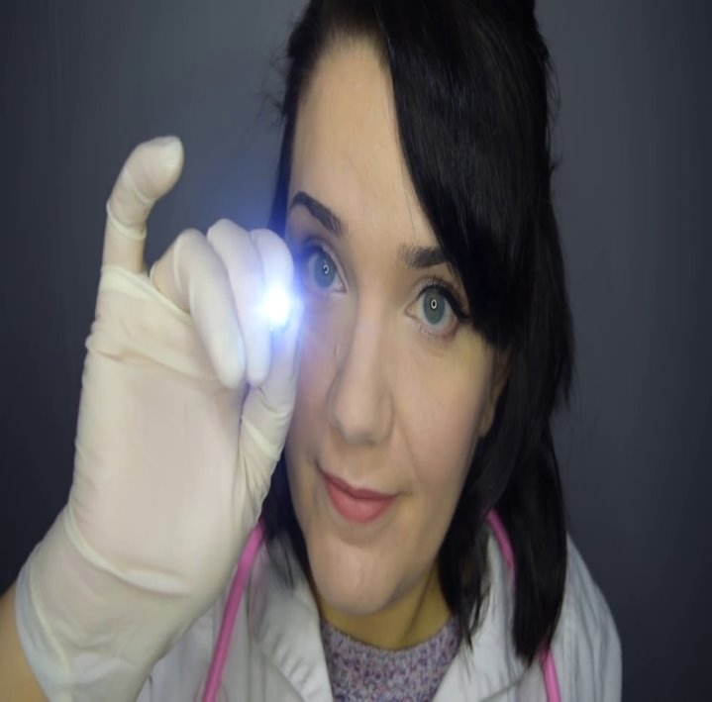
Persona 3: Lisa the Caring Nurse
Background Profile:
Lisa has 15 years of experience as a Nurse at various urgent care facilities. Now, during global COVID-19 pandemic, many of her patients complain to her about the waiting period to see a doctor.
How can SymCheck help?
In order to help minimize the number of patients in the office, Lisa seeks an application to help her patients determine whether or not their illness symptoms require immediate medical attention.
Given that Lisa wishes to refer her patients to a reliable, and convenient source of diagnosis, the SymCheck application could potentially offer guidance in determining what a patient's symptoms may indicate and thus provide recommendations for at-home remedies.
The use of SymCheck could thus also help in mediating the spread of COVID-19 by reducing the traffic in Urgent Care facilities.

Slide 8

Looking forward into this semester...
This year our team plans to undertake an extensive focus on adding various additional features to our application to make it even more convenient and user/patient friendly:
Image upload preview
Interactive chatbot
Convenient site navigation bar
Mobile-friendly website
Our team is also looking into adding more data to increase the accuracy of our existing prediction rates, as well as considering the addition of another non-threatening illness/condition
Current machine-learning algorithm accuracy: 78%
Addition of classification label for ringworm (tinea or dermatophytosis)
Image drawn from Shutterstock

Slide 9
Sprint 4 vs. Sprint 5

Slide 10
Comparison
Sprint 4
Sprint 5
We completed our machine learning algorithm to diagnose Chickenpox and Pinkeye.
The accuracy percentage is 78
We provided information about these illnesses such as when to see a doctor and typical symptoms.
This information is from the CDC
We added “Find nearest Emergency room” feature to our Image page and Results page.
Patients can find the nearest hospital or urgent care from their location
We added a new capability that allows you to see the image uploaded for confirmation purposes.
We added a chatbot to each page that acts as a virtual assistant for SymCheck.
It can direct users to various resources such as our GitHub, the CDC website, or reach us via email
We hosted our application to the cloud for easier accessibility.
Users can access SymCheck on any laptop or desktop
There is no need to install and run SymCheck on your device

Slide 11


Sprint 5 New Technologies
Natural language understanding platform
Dialogflow can analyze multiple types of input (text or audio inputs)
Advanced AI : BERT-based natural language understanding (NLU) model
Interactive, console-based, programming environment
Multi languages support
manage the environment for building and running code

Slide 12
Sprint 5

Slide 13
Sprint 5 Committed Tasks and Stories

Slide 14
Sprint 5 Completed Tasks and Stories
Items boxed in green were added mid-sprint
This was possible because repl.it is a collaborative coding environment and provided hosting capabilities.

Slide 15
Acceptance Criteria
Key | Summary | Label
HID-57 | Given that the patient is on the ImageUploadPage, when the patient uploads their image, then the user should see their uploaded image within the application. | Image Upload Page
HID-58 | Given that the patient is on any page of the SymCheck application, when the patient clicks on the chatbot's greeting, then a dialogue window will pop up in the bottom right corner. Given that the patient has a dialogue box opened with the chatbot, when the patient enters "pinkeye" or "chickenpox", then the chatbot will respond by telling the patient they should go to the CDC website. | All Pages
HID-62 | Given that the patient has a browser open, when the patient types in SymCheck's URL, then the SymCheck application should be accessible without any errors. | Cloud Access

Slide 16
Test Cases
Test Case For | Key | Test Cases | Test Data | Expected Results | Actual Results | Pass/Fail
Homepage | HID-58 | Chatbot | Hi, chicken pox, pink eye | Patient can interact with SymBot and receive a response | SymBot responds on all patient inputs such as hello, what is chickenpox, how can I speak to creaters of symcheck, etc. | P
Image Upload Page | HID-57 | Image reflection | pinkeye image file | Patient can see their uploaded image | After you select an image to upload, the page shows you the uploaded image | P
Image Upload Page | HID-58 | Chatbot | How do I upload an image? | Patient can interact with SymBot and receive a response | SymBot responds on all patient inputs such as hello, what is chickenpox, how can I speak to creaters of symcheck, etc. | P
Results | HID-58 | Chatbot | How can I get in touch with developers? | Patient can interact with SymBot and receive a response | SymBot responds on all patient inputs such as hello, what is chickenpox, how can I speak to creaters of symcheck, etc. | P
Cloud Access | HID-62 | Access via URL | https://symcheck.jazzymaya.repl.co/ | Patients can use SymCheck without any issues | Patients can use SymCheck without any issues | P

Slide 17
Sprint 5 Burndown Chart
This chart shows our story point burndown.
We have a velocity of 13 points.
We added an 8-point story mid sprint, that is why there is a spike on the 17th.
We finished the sprint early, that is why the red line stops on the 18th.

Slide 18
Project Demo
*Demo was performed live and can be found at https://github.com/jazzymaya/HiddenAgility/wiki

Slide 19
Demo of New Capabilities
New Image Page Capability
Chatbot Capability

Slide 20
Product Backlog

Slide 21
Product Backlog

Slide 22
Timeline

Slide 23
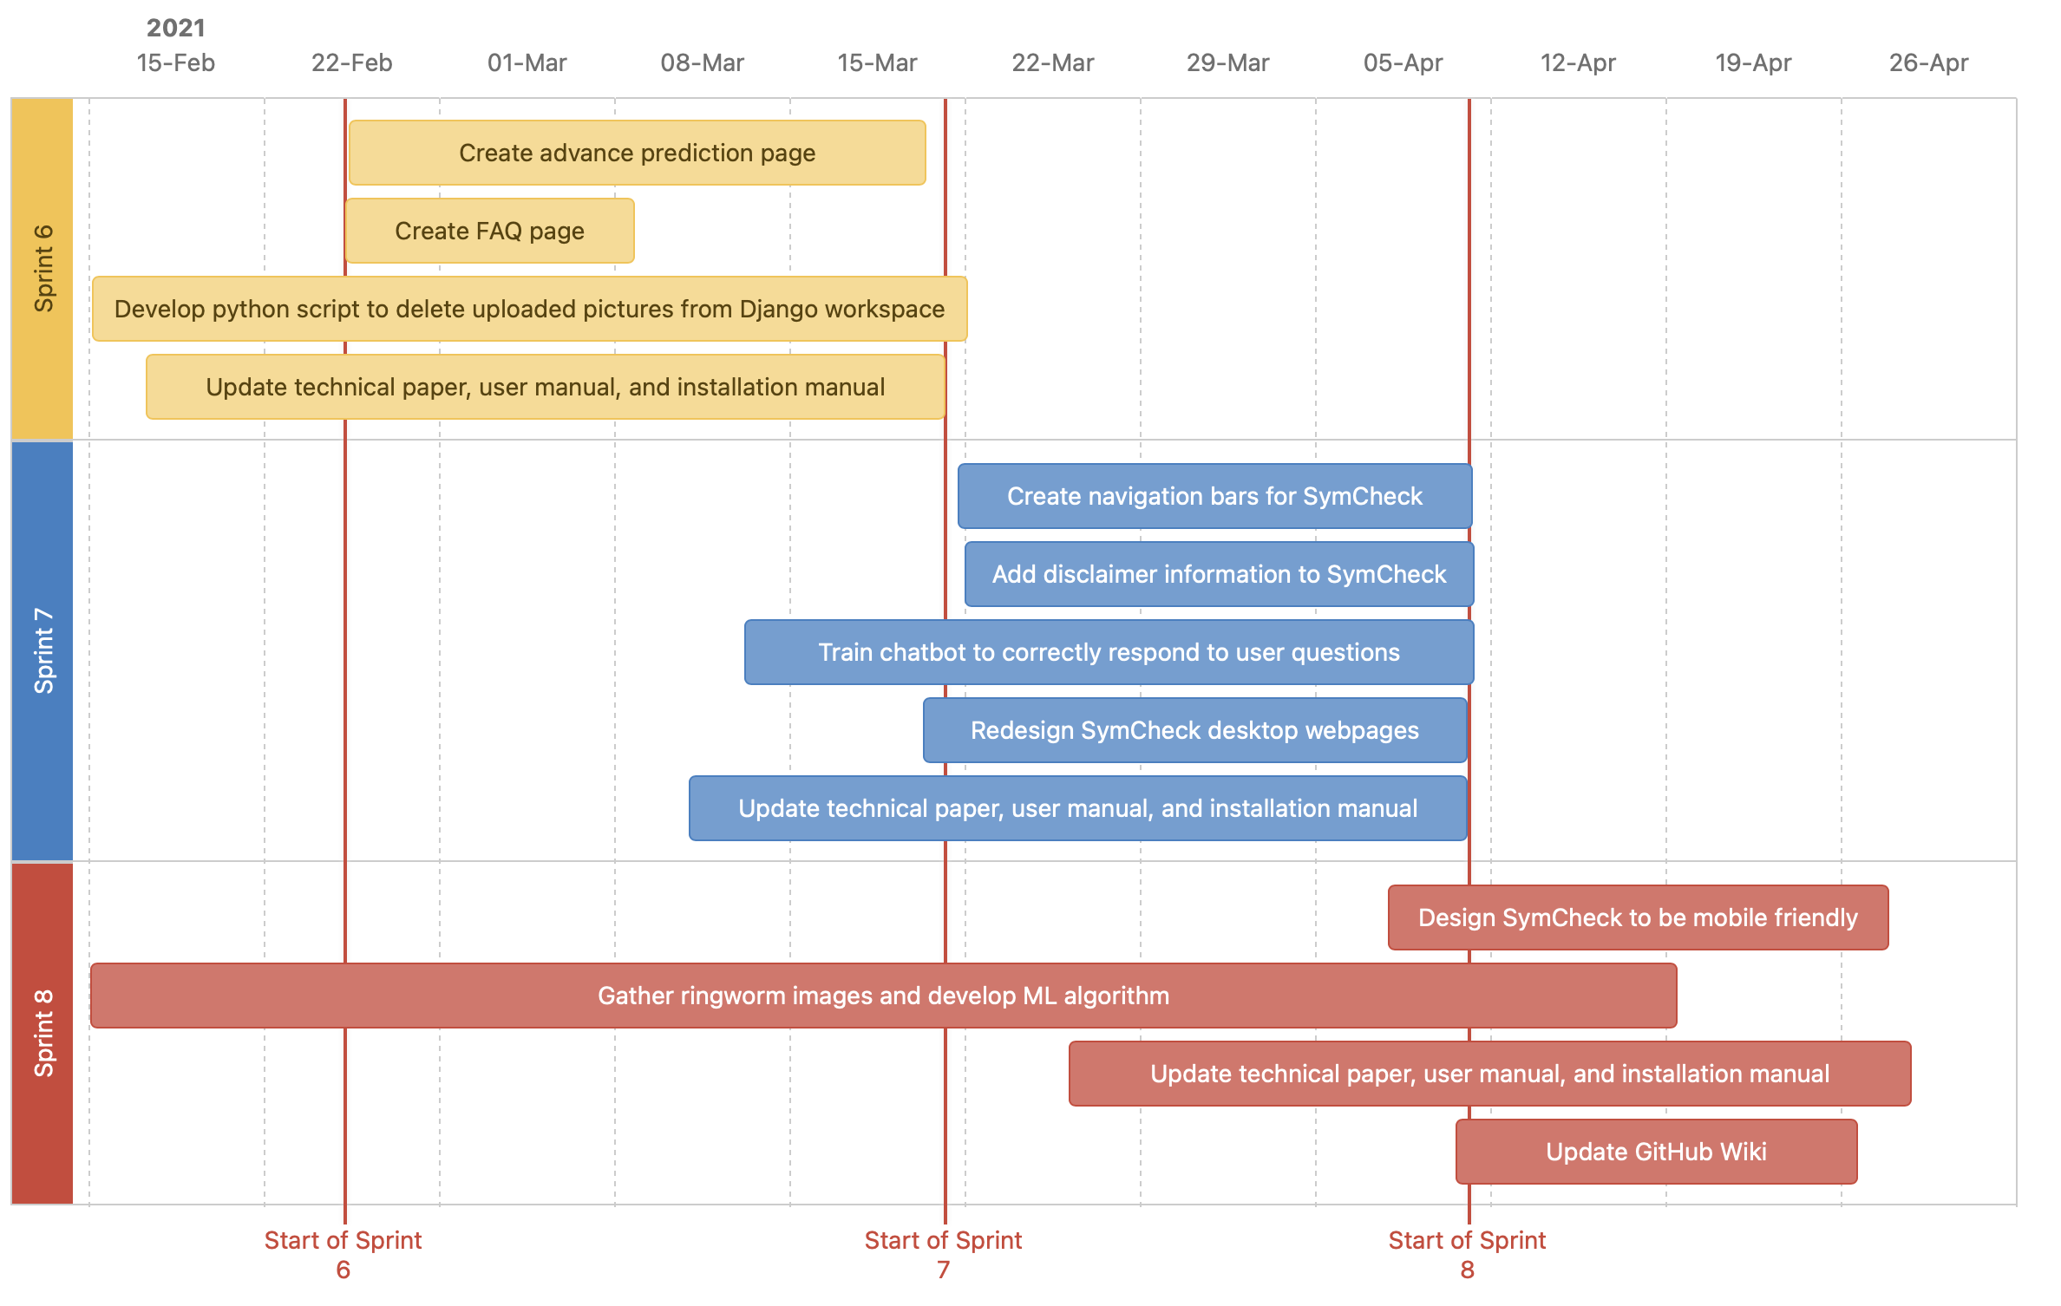
Timeline of Future Sprints

Slide 24
Retrospectives

Slide 25
Retrospectives
What went well
Using repl.it as our code collaboration tool and cloud hosting provider
Tri-weekly meetings to make sure roadblocks are avoided
What needs improvement
Sprint planned items needs to be enforced to avoid mid sprint scope changes
We need to work on stories and tasks in a timely manner
Next Steps
Read repl.it documentation for better understanding

Slide 26
Conclusion

Slide 27
Link to GitHub
https://github.com/jazzymaya/HiddenAgility/wiki
Link to SymCheck Website
https://symcheck.jazzymaya.repl.co/

